Slide 1
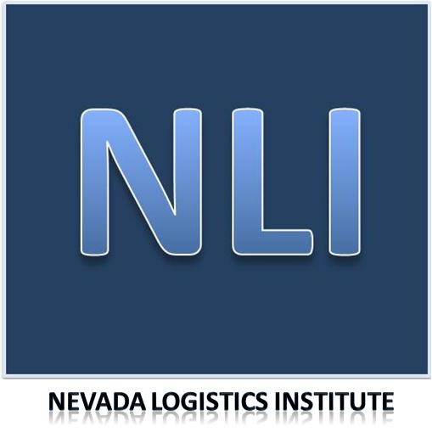
Missao Tecnica Course Introduction
Dr. Dale S. Rogers
Nevada Logistics Institute
Reno, NV
21 July 2019

Slide 2
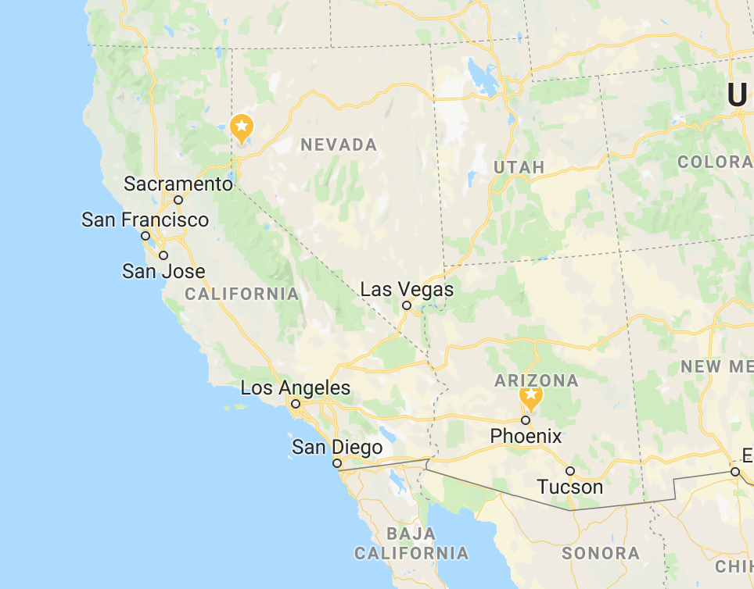

Slide 3
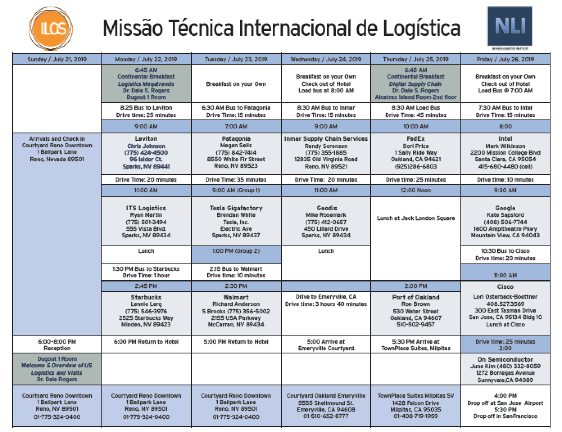

Slide 4
Tuesday Schedule

Slide 5
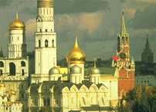
Structure Drives Behavior
Structure determines behavior
Behavior does not determine structure

Slide 6

Differences between Brazil & US Business
Brazil
Best solution
Taxes big issue
Interest rates big issue
Technology
US
Sufficient solution
Taxes not as much of an issue
Interest rates important but not problem
Technology that is cheap

Slide 7
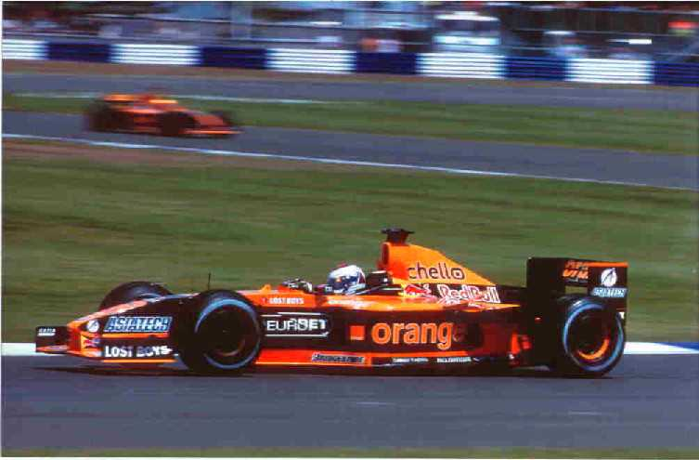
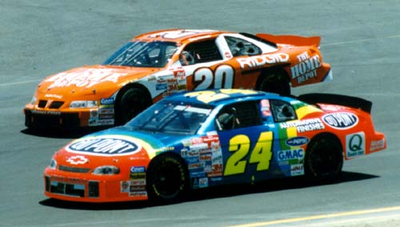
NASCAR vs. F1

Slide 8

Leviton
Electrical Distributor
Privately Held
Semi-Automation
Cost-Cutter

Slide 9
ITS Logistics
Third-Party Logistics company (3PL) that provides personalized supply chain solutions with an asset-based dedicated fleet, warehousing and distribution services
Nationwide multi-modal freight brokerage.
Founded in 1999 by former University of Nevada Logistics students, ITS Logistics operates daily throughout the U.S.

Slide 10
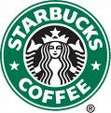
Starbucks Manufacturing Plant
Coffee roasting plant
Good Manufacturing Practices (GMP)
High-margin business
High-growth business
State-of-the-art facility

Slide 11
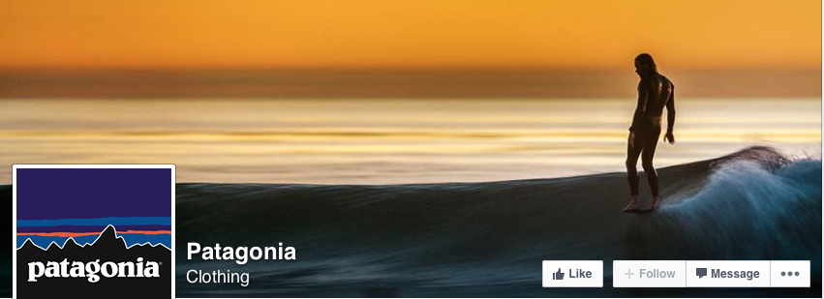
Patagonia
Apparel Firm
Environmentally Friendly
Innovative warehouse
Flexibility and agility

Slide 12
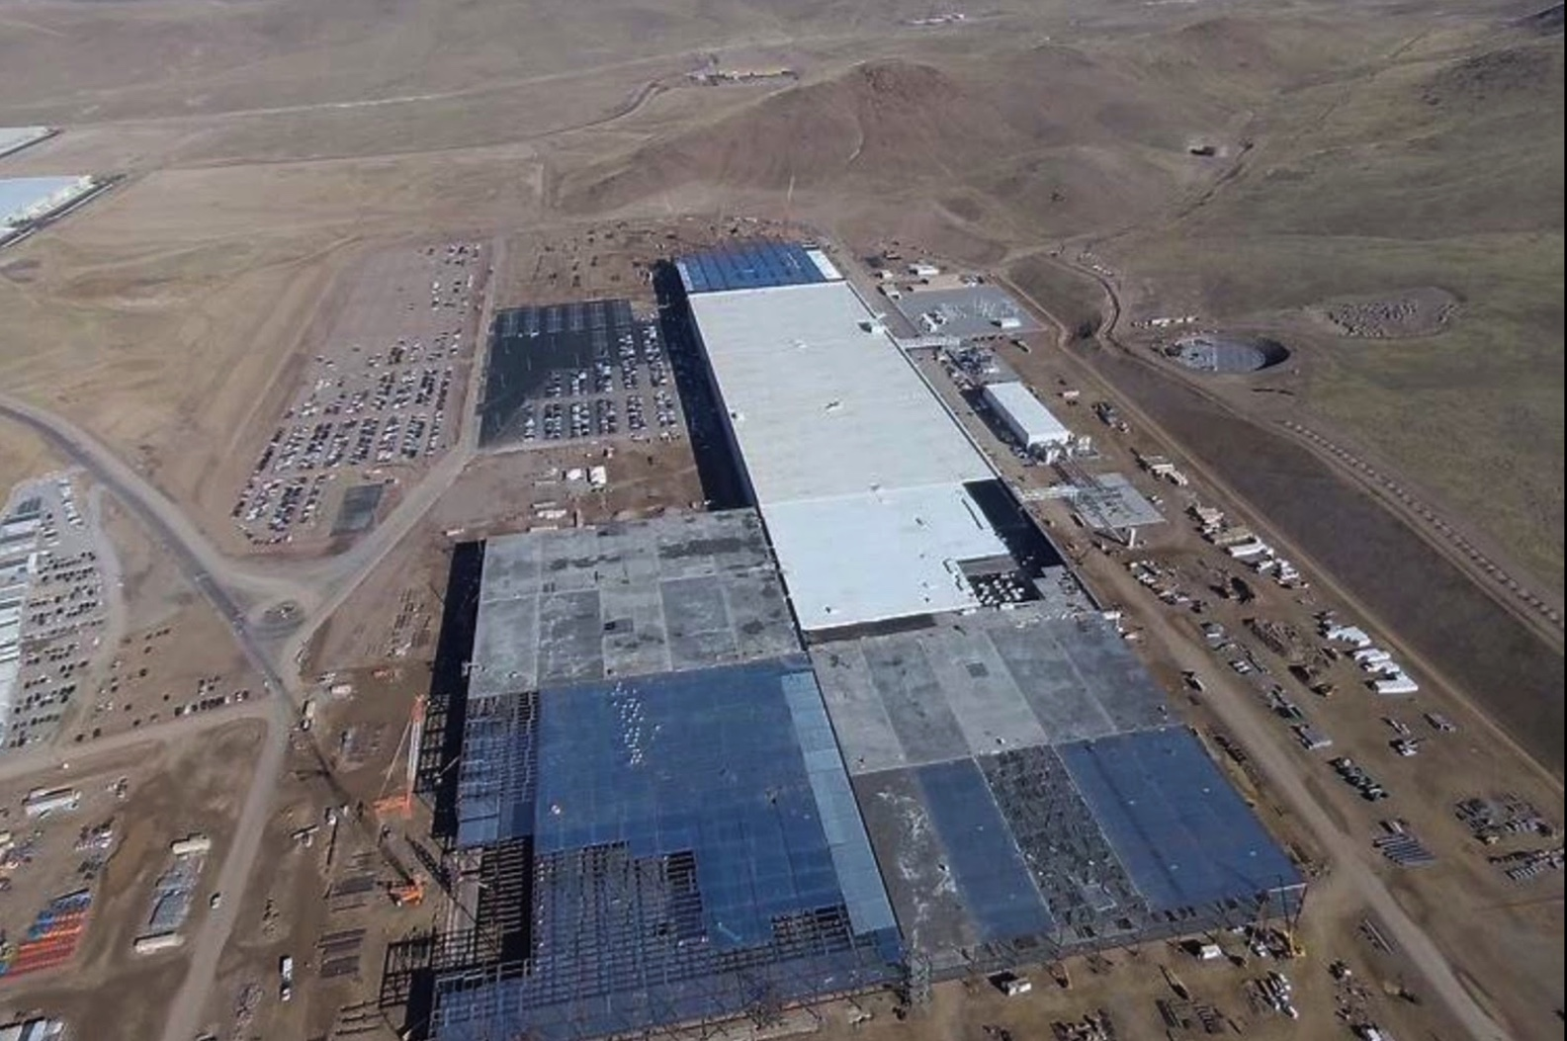
Tesla Gigafactory

Slide 13
Inmar
Reverse Logistics
Started out as food processor (CLS)
Small facility
https://www.youtube.com/watch?v=BAW9xVJCxJc
https://www.cbsnews.com/news/many-happy-returns-secondary-market-and-liquidators-reselling-your-returned-stuff/
https://www.cbsnews.com/video/when-customers-return-high-end-fashions/

Slide 14
Geodis (formerly OHL Logistics)
Innovative 3PL
Recently acquired by French Railroad firm
Known for fulfillment and omnichannel innovation
Innovative but practical
Customers include Apple, Duluth Trading and several ecommerce firms

Slide 15
GEODIS
Part of SNCF Logistics
number one Transport and Logistics operator in France and ranked number four in Europe.
Locations in 67 countries and a global network spanning over 120 countries.
Five lines of business
Supply Chain Optimization, Freight Forwarding, Contract Logistics, Distribution & Express and Road Transport), GEODIS manages its customers Supply Chain by providing end-to-end solutions enabled by our people, our infrastructure, processes and systems.
Acquired OHL in 2015
GEODIS has more than 160 sites in the US.
Services a total warehousing surface of more than 37,673,685 sqf where a wide range of industry sectors are served.

Slide 16
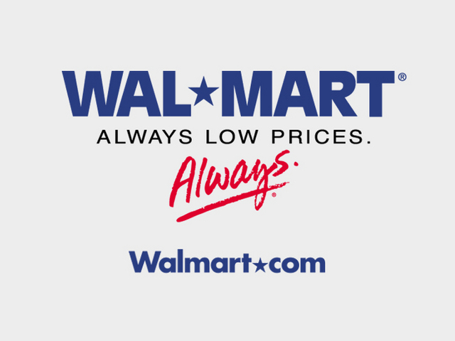
Wal-Mart Distribution Center
Largest retailer in the world
Grocery distribution center
Talented supply-chain managers
New facility – opened August 1, 2006

Slide 17
FedEx
Major U.S. hub
Oakland Airport
New transportation developments
Firm in transition

Slide 18

Port of Oakland
Fourth largest container port in the U.S. (after Los Angeles, Long Beach and Charleston)
Important west coast port
Much regulation
Over-taxed
Hard to make changes quickly

Slide 19
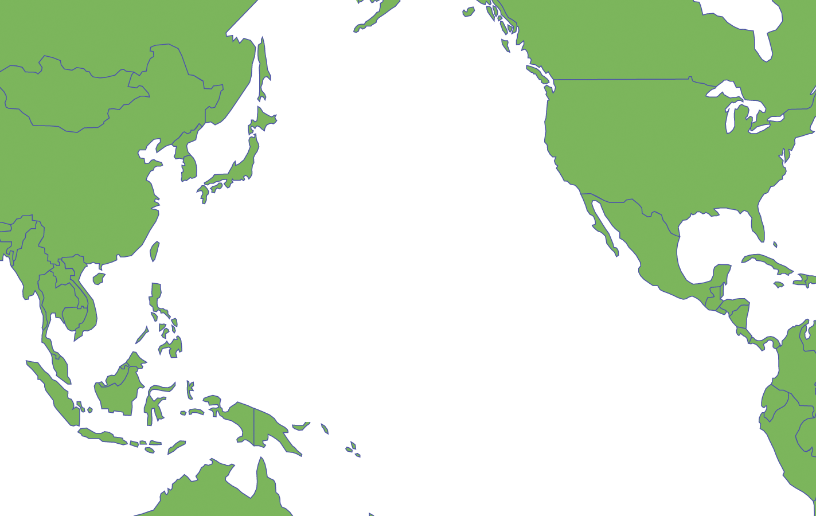

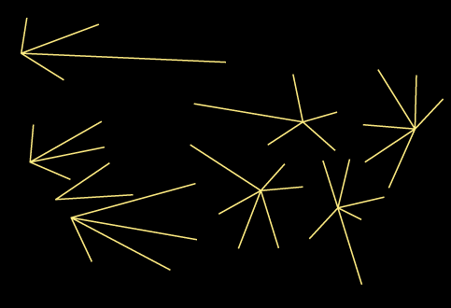
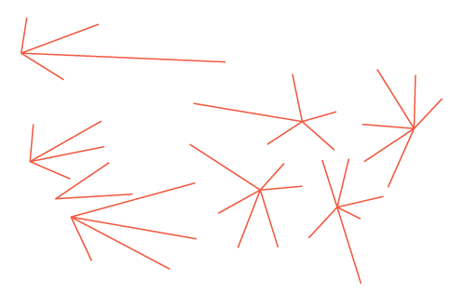
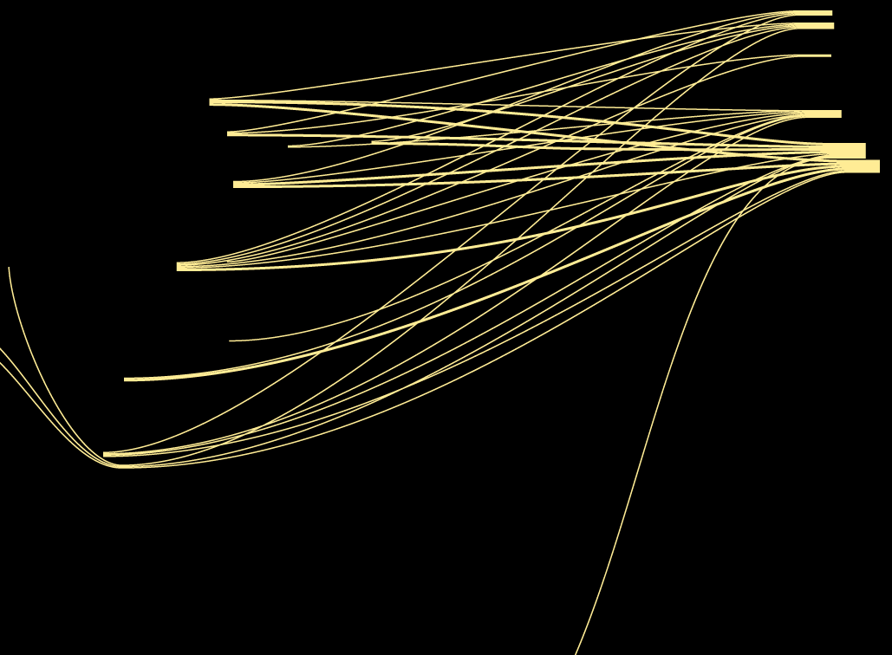
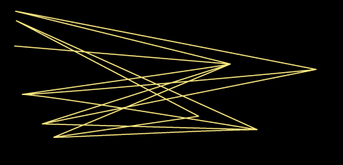
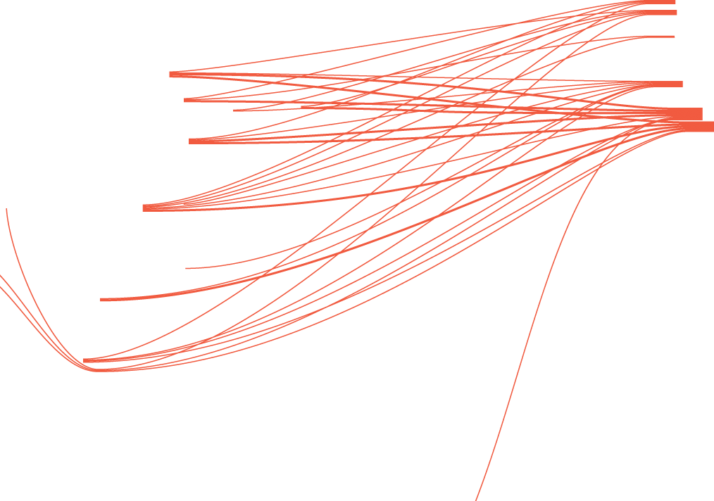
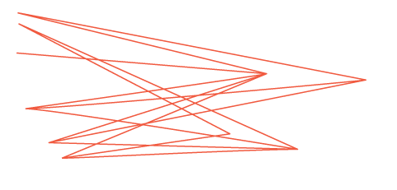

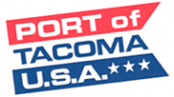




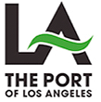

Extensive Shipping Service Options
Seattle
Tacoma
Portland
Oakland
Los Angeles
Long Beach
Service String Choices
25+ Carriers
50+ Unique Service Strings
Calling at over 80 ports in 36 countries
100+ Sailings to/from the West Coast per week
Notes:
19

Slide 20
Intel
High tech
Great at R&D
King of the microprocessors
Innovation

Slide 21
Google
Search firm
Android
More supply chain management than originally intended
Former students

Slide 22
Cisco
High Tech
Routers, switches and all things Internet
Important firm in connecting the world
Innovation

Slide 23
ON Semiconductor
Analog Devices
Formerly Fairchild Semiconductor
ON Semiconductor is old Motorola Analog Devices

Slide 24
